Slide 1
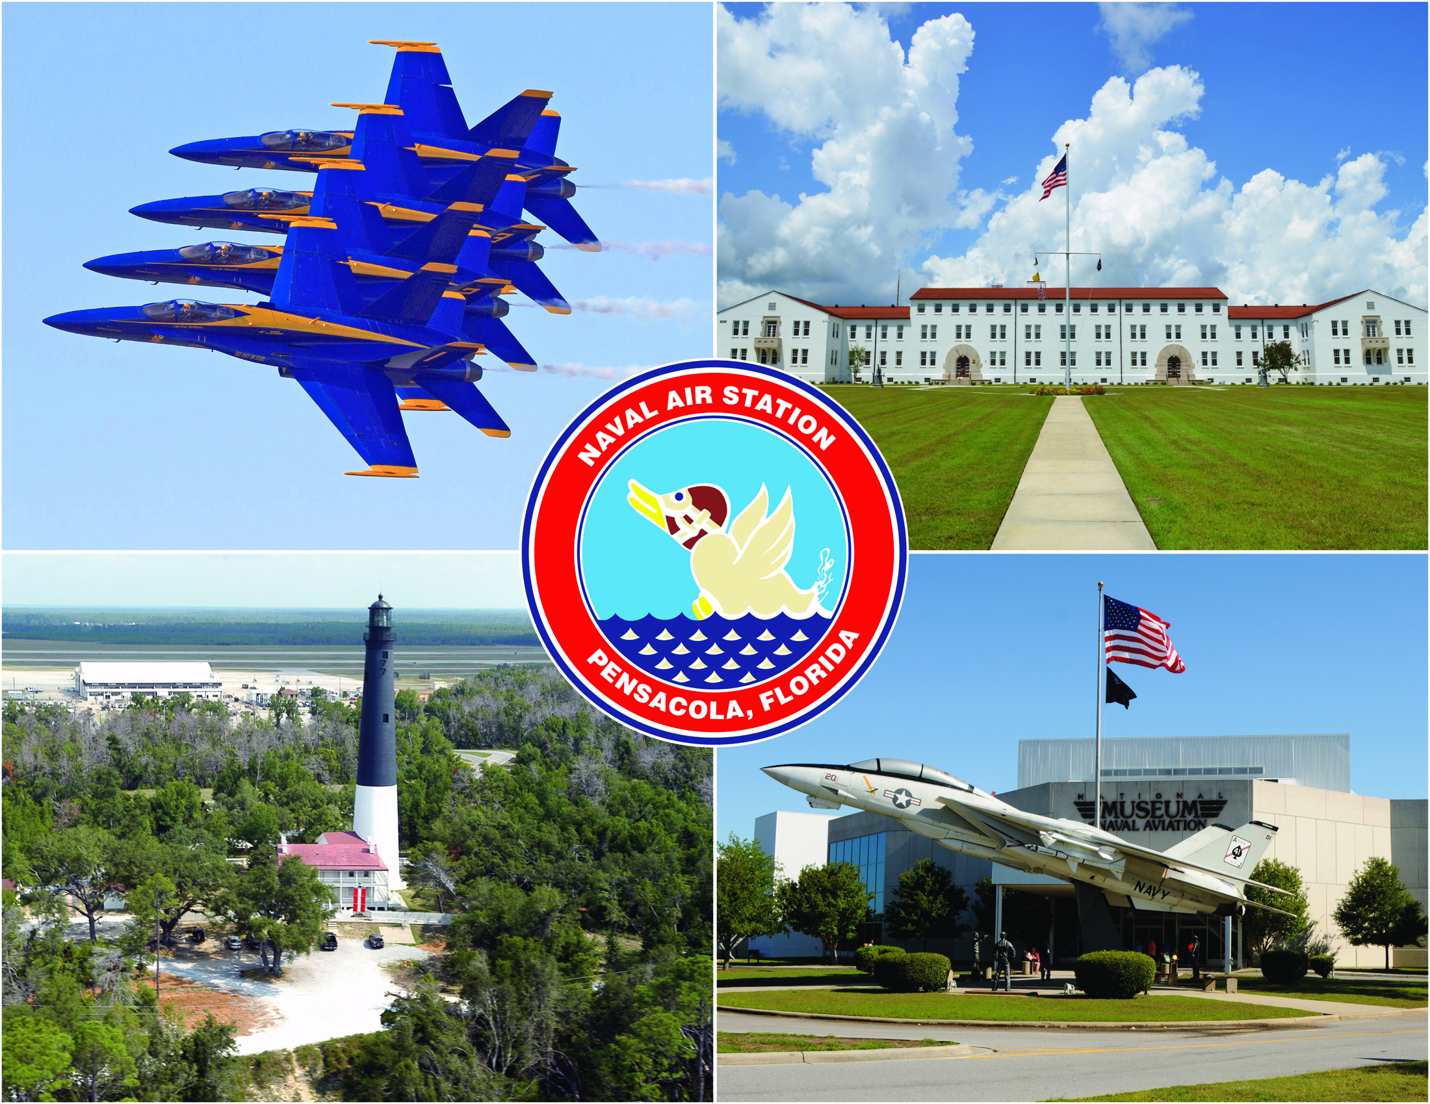
Naval Air Station Pensacola
The Cradle of Naval Aviation

Slide 2
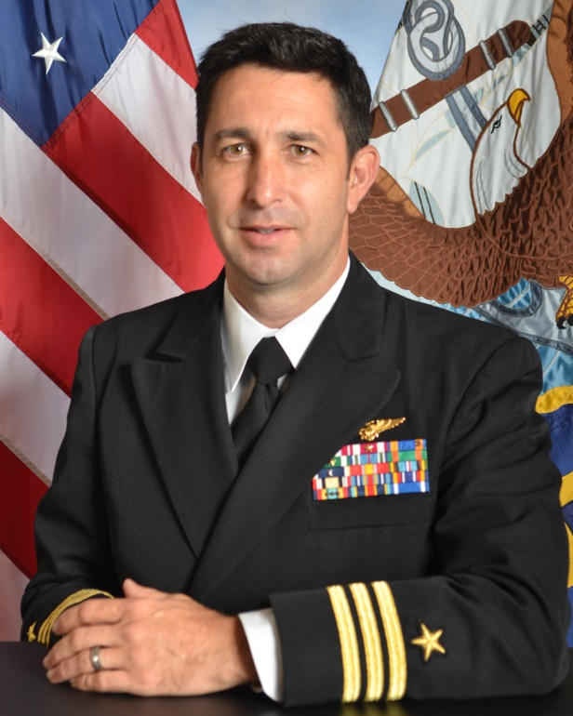
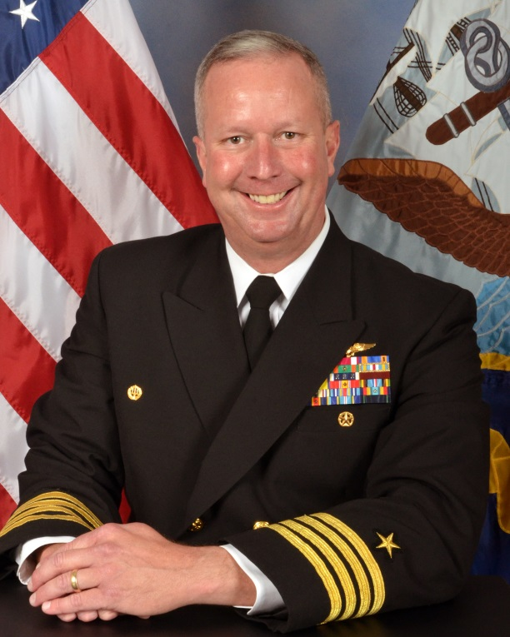
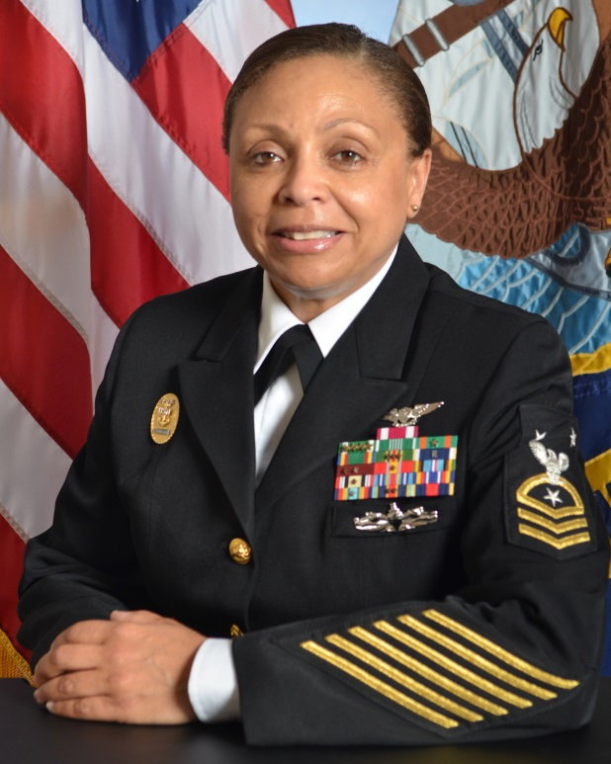
Naval Air Station Pensacola
“The Cradle of Naval Aviation”
CDR Shawn Dominguez
Executive Officer
CAPT Christopher Martin
Commanding Officer
CMDCM Adriana Lewis
Command Master Chief

Slide 3
Brief Overview
Base Info
Housing
Environmental
Energy
Public Works Project
Current/Future Operations

Slide 4
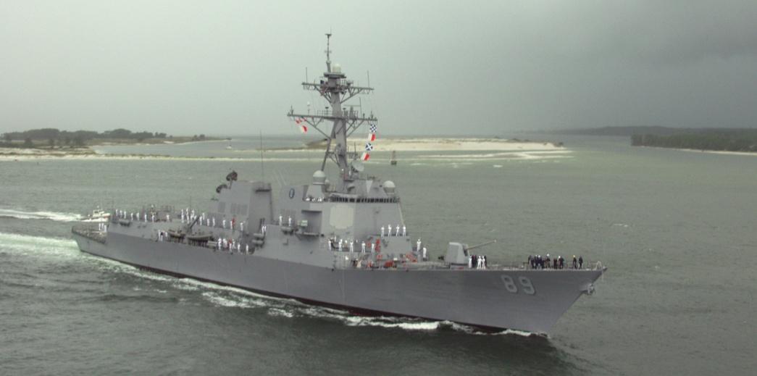
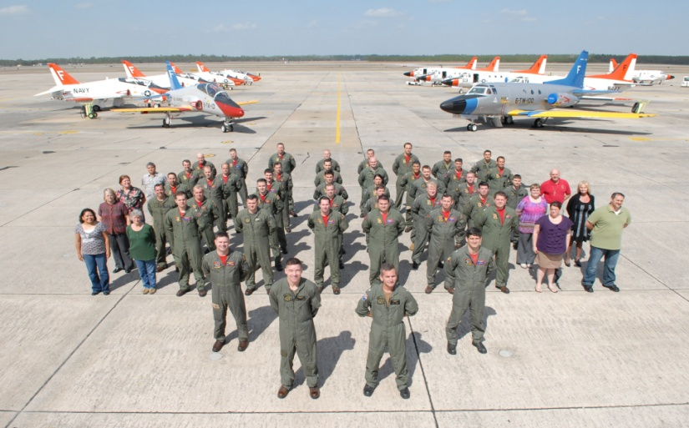
Mission
To efficiently Deliver the very best
Readiness From The Shore

Slide 5
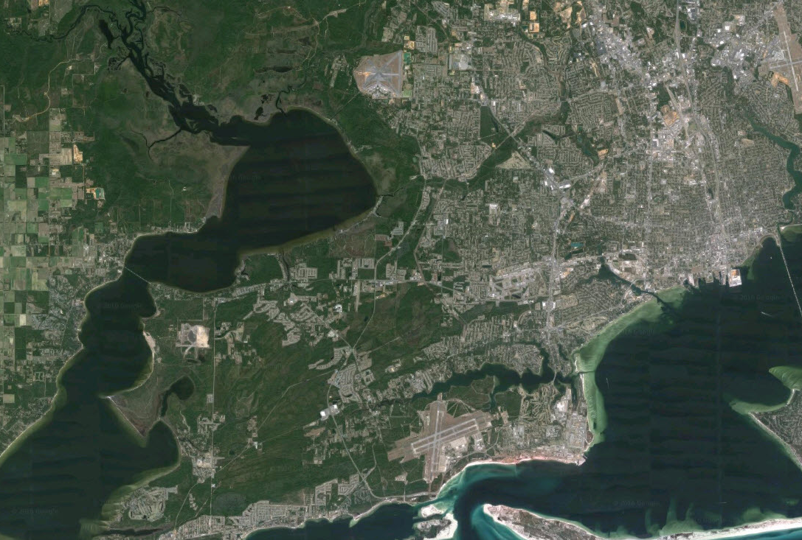
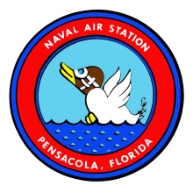
Naval Air Station Pensacola AOR
Corry Station
Saufley Field
Saufley Fld
Naval Air Station Pensacola
Corry Station
Blue Angel Park/Bronson Fld
NAS Pensacola
Notes:
NRSE BIGGEST INSTALLATION: PHYSCIALLY – TROOPS -- $$

Slide 6
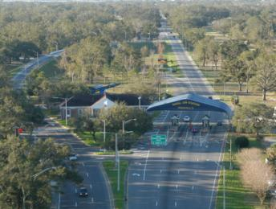
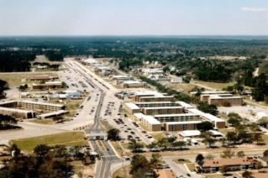
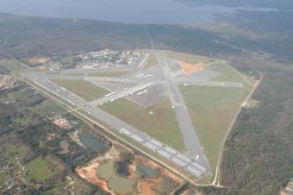
Naval Air Station Pensacola Today
1,501 Operational Buildings and Structures
24M Square Feet of Buildings and Structures
$3.6B Plant Replacement Value
8,622 Acres in 4 Distinct Sites
225 Miles of Roadway
549 Housing Units
95 DoD Tenant Commands
31 Non-DoD Tenant Commands

Slide 7
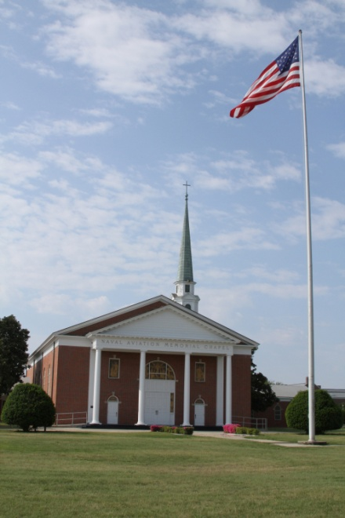
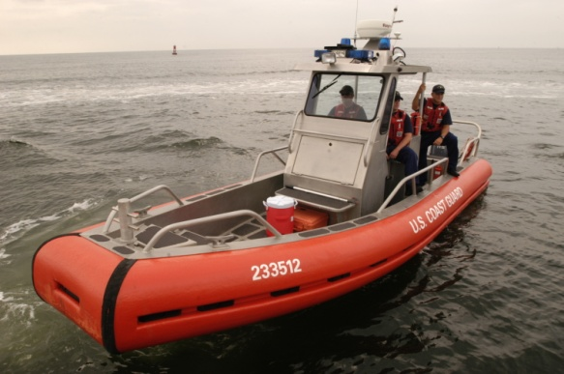
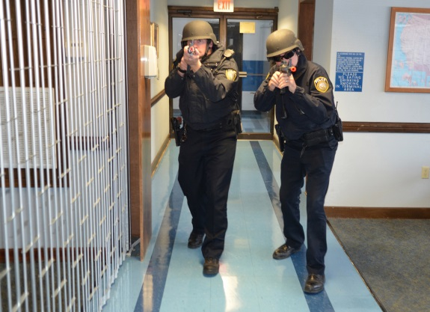
Base and Fleet Support
Support services NAS Pensacola provides to tenants and the fleet:
• Air Operations • Port Operations
• Public Works • Weapons/Munitions
• Safety • Billeting/VQ
• Galley • Religious Services
• Security/Force Protection • Communication
• Fleet and Family Support • EKMS
• Fire and Emergency Services • ELMR Radios
• Morale, Welfare, and Recreation
Note: NAS Pensacola is 1 of 4 installations in the Continental U.S. with an active airfield and a deep-water port.

Slide 8
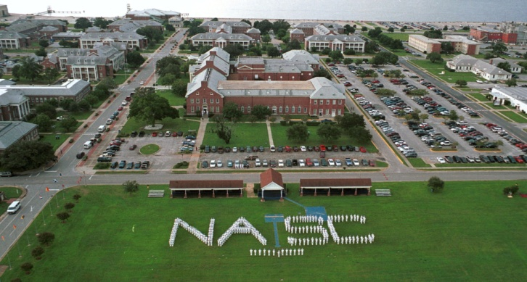
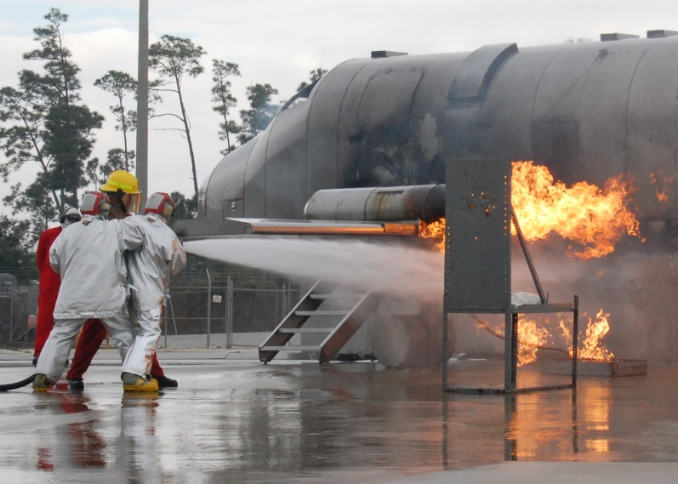
Major Tenant Commands
• Naval Education and Training Command
• Center for Naval Aviation Technical Training
• Center for Information Dominance
• Naval Aviation Schools Command
• Training Air Wing SIX
• Naval Air Technical Training Center
• Marine Aviation Training Support Group-21
• Marine Aviation Training Support Group-23
• Naval Medicine Operational Training Center
• Naval Survival Training Institute
• Navy Orientation Recruiting Unit
• 479th Flying Training Group (USAF)

Slide 9
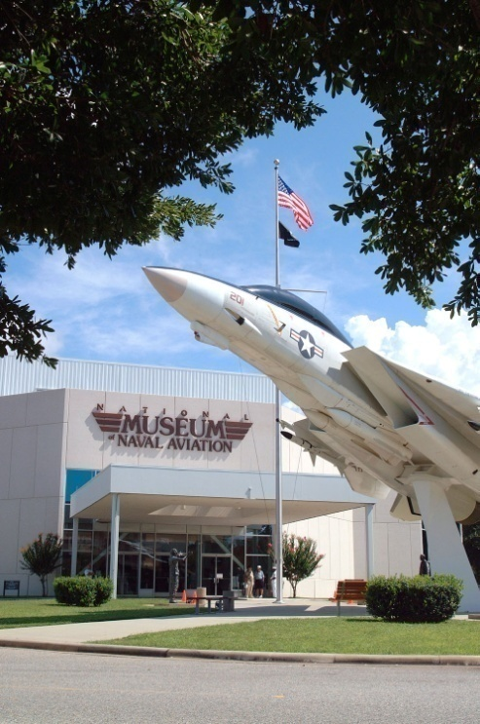
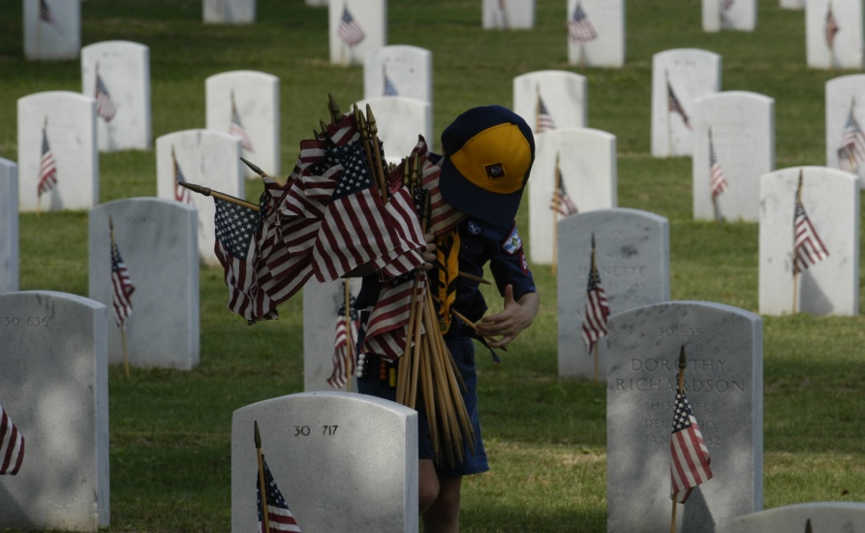
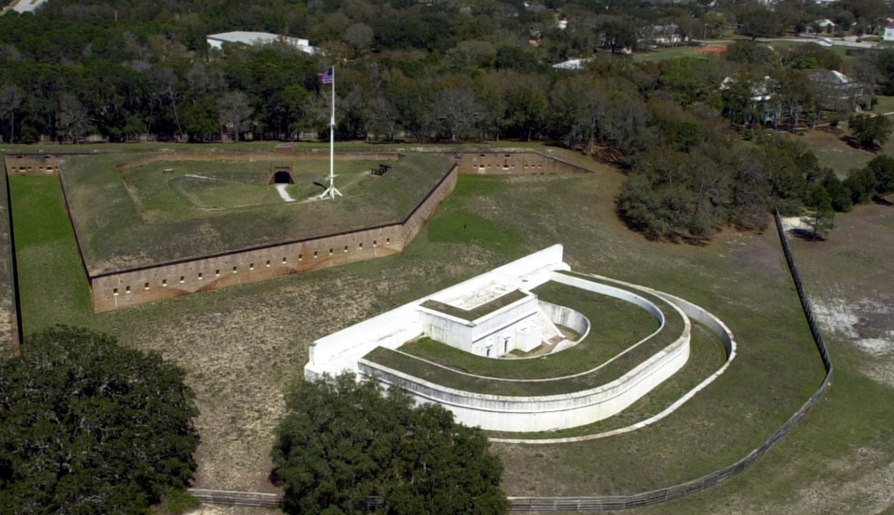
Major Tenants
• Navy Information Operations Command
• Naval Flight Demonstration Squadron (Blue Angels)
• Naval Education and Training Security Assistance and Field Activity
• U.S. Coast Guard
• 350th Civil Affairs Command (U.S. Army Reserve)
• National Naval Aviation Museum
• U.S. Department of the Interior
• Department of Homeland Security
• Department of Veteran Affairs - Barrancas National Cemetery

Slide 10
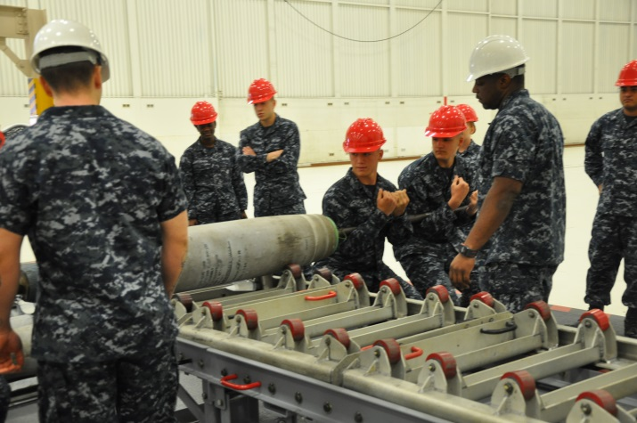

Training Aboard NAS Pensacola
• Aviators for Navy/Marine Corps/USCG/Air Force and Foreign Allies
• Aviation Maintenance • Rescue Swimmers
• Intelligence • Water Survival
• Cryptology • Language
• Information Technology • Flight Surgeons
• Aviation Safety • Enlisted Aircrew
• Aviation Physiology
NAS Pensacola Training Command’s graduate 59,000 students annually; representing every branch of service and foreign allies.

Slide 11
Courses of Instructions offered to Military
International Partners in the Pensacola area
• Introductory Flight Training • Explosive Ordnance Disposal (EOD) Prep
• Advance Aircrew Tactical Jets • Cryptologic Technician Maintenance
• Air Traffic Control • Weapons Systems Officer Training
• Helicopter Flight Training • Aviation Maintenance Officer
• Electronic Warfare • Crew Resource Management
• Flight Surgeon • International Anti-Terrorism/Anti-Piracy
• Aviation Safety Officer • International CPO/WO Leadership
• Division Officer Leadership • Aviation Enlisted Maintenance (12 Ratings)
• Fundamental Skills In Electricity, Electronics and Mechanics
• Manpower, Personnel, Training & Education Course

Slide 12
Economic Impact (2012)
Personnel Salary
Military 17,076 $856,061,515
Civilian (Appropriated) 2,667 $194,383,266
Civilian (Non-Appropriated) 1,362 $29,607,680
Contract 1,886 $98,303,753
Subtotal 22,991 $1,178,356,214
Purchase Card/Labor Contracts:
Appropriated Fund $98,904,398
Non-Appropriated Fund $4,283,652
Subtotal $103,188,050
Grand Total Economic Impact: $1,281,544,264

Slide 13
Economic Impact
Total County Economic Impact (in Millions)
County Economic Impact (Gross Economic Impact) $7,184.1
Sales Activity $4,547.2
Consumption $2,977.1
Capital Investment $708.6
Employment 63,293 jobs
Direct Defense Spending (in Millions)
Procurement $340.7
Salaries $1,282.5
Pensions & Transfers $587.7
Total Defense Spending $2,210.9

Slide 14
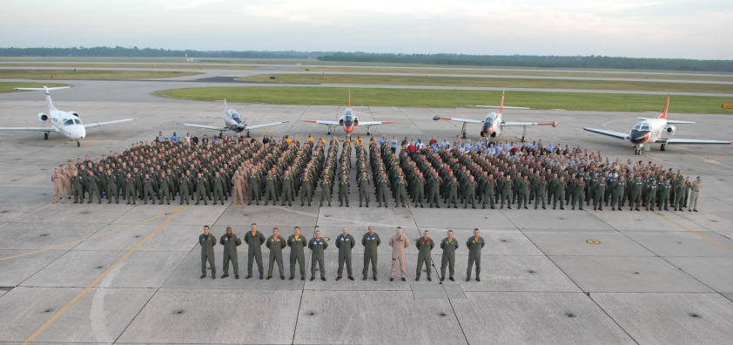

Escambia County
41K Veterans
11K Military Retirees
15% of Population
46% Gross Regional Product
Average Civilian Salary: $38,584
Average Military Salary: $73,554

Slide 15
Family Housing Snapshot (PPV)

Slide 16
Environmental
Environmental Partnerships:
  Integrated Natural Resource Management Plan (INRMP) Stakeholders (U.S. Fish & Wildlife Service, Florida Fish & Wildlife Conservation Commission)
  U.S. Forest Service
  U.S. Forest Service Prescribed Fire Training Center, U.S. National Park Service
  U.S. Bureau of Prisons
  Florida Department of Environmental Protection
  Florida Forest Service
  NW Florida Wildlife Sanctuary
  Auburn University Longleaf Alliance
  Gulf Coastal Plain Ecosystem Partnership (GCPEP)
  Friends of the Perdido Pitcher Plant Prairie
  Audubon Society
  Student Conservation Association - 29 Interns since 1993 (18,000 hours of Americorps service volunteers)
Compliance Partnering: Navy, Air Force, and FL Dept. of Environmental Protection (FDEP)
Installation Restoration Partnering: Navy, EPA, and FDEP
Notes:
List CNO/SECNAV level recognition for the last 3 years. (e.g. CNO/SECNAV Environmental Awards, etc.)
What operations on the base create the most significant environmental impacts?
What environmental inspections have you had the last year? What was the outcome?
Any notices of violations? If yes, have they been closed out or what is required to correct the deficiency? Include amount of any fines assessed.
Are any environmental issues affecting your base?
Are you engaged in any environmental partnerships with outside agencies, non-governmental organizations, compliance partnering, etc…
Do you have any Stormwater fees levied against your Installation? Explain.
Is your Environmental Management System (EMS) fully conforming with the 18 elements of ISO 14001?

Slide 17
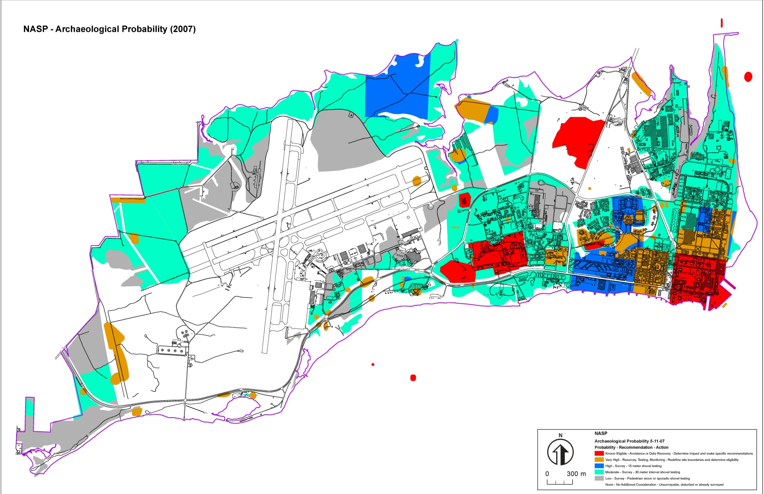
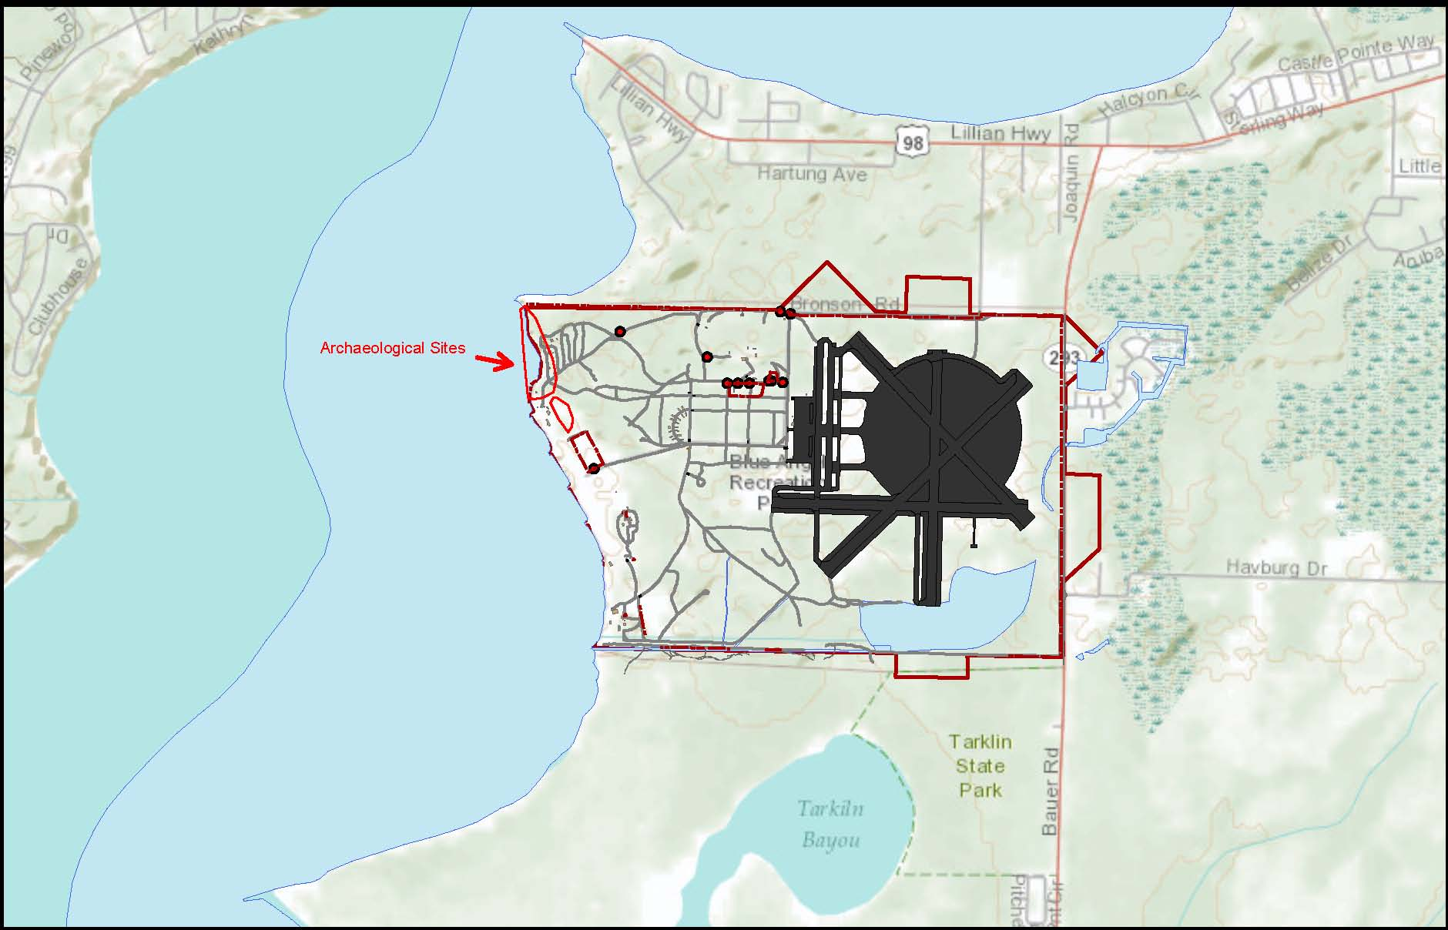
Environmentally Sensitive Areas
CULTURAL RESOURCES
1 National Historic Landmark District-Pensacola Naval Air Station Historic District
8 Historic Districts
Over 200 Historic Buildings and Standing Structures listed or eligible for National Register of Historic Places listing
Significant Archeological findings
  84 Archeological Sites and Numerous Sensitive Areas
  1,250 Cubic Feet of Artifacts curated on base
Known occupation since 700 AD
Continuous military use since 1600s
  Spanish, French, British and American occupations
  U.S. Navy Yard established 1825
  NAS Pensacola established 1914
Notes:
Insert map or describe any environmentally sensitive areas of the installation.
Answer the following questions in bullet format:
What land is restricted in its use due to environmental factors?
What historical or cultural resources do you have? Any impacts?
What restoration sites do you have? How many have been closed? What follow on actions are required?

Slide 18
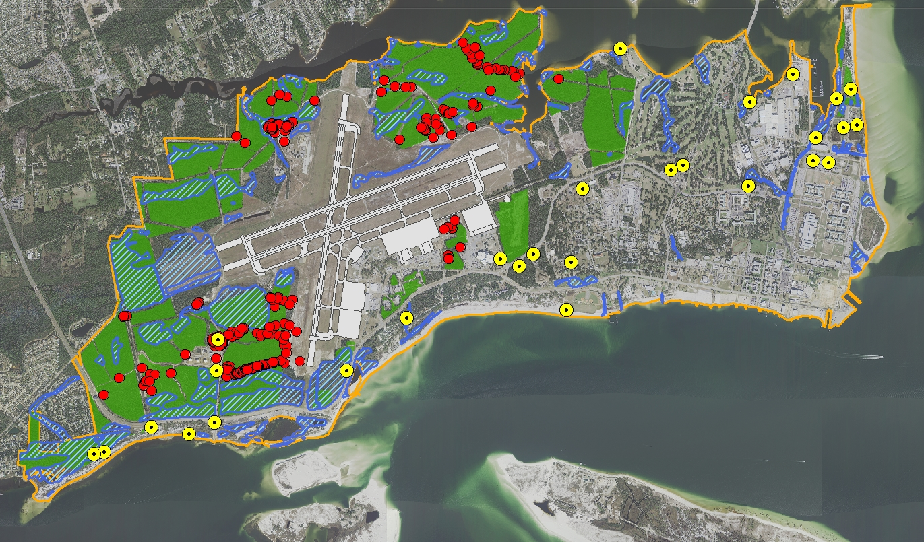

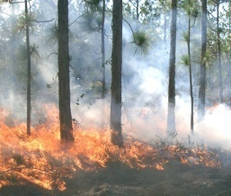
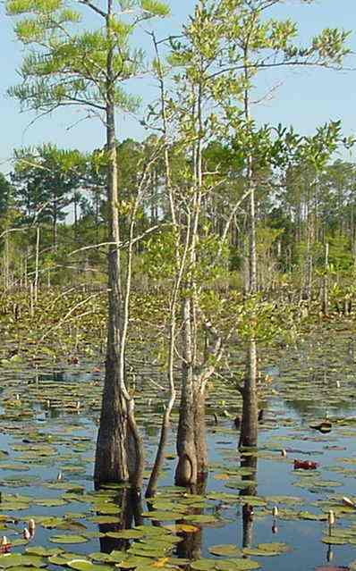
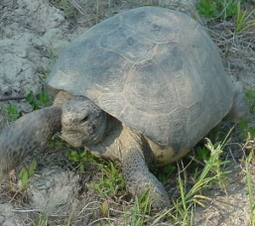
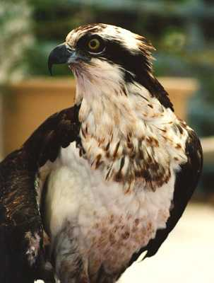
Environmentally Sensitive Areas
Forest/Wetlands:
  NAS Pensacola Complex: 2,500 acres forest/ 679 acres wetlands, 17 miles of shoreline
Protected Species (31 species):
  Birds (Osprey, Bald Eagle, Brown Pelican)
  Reptiles (Gopher Tortoise, Alligator Snapping Turtle)
  Plants (Pitcher Plants, dune and wet prairie species)
NR Program Highlights:
  Student Conservation Association 29 interns (20 yrs)
  Tree City USA (18 years)
  International Coastal Cleanup (24 yrs)
  Gulf Coastal Plain Ecosystem Partnership Charter Member
FOREST WETLANDS GOPHER OSPREY
TORTOISE
Notes:
Insert map or describe any environmentally sensitive areas of the installation.
Answer the following questions in bullet format:
What land is restricted in its use due to environmental factors?
What historical or cultural resources do you have? Any impacts?
What restoration sites do you have? How many have been closed? What follow on actions are required?

Slide 19
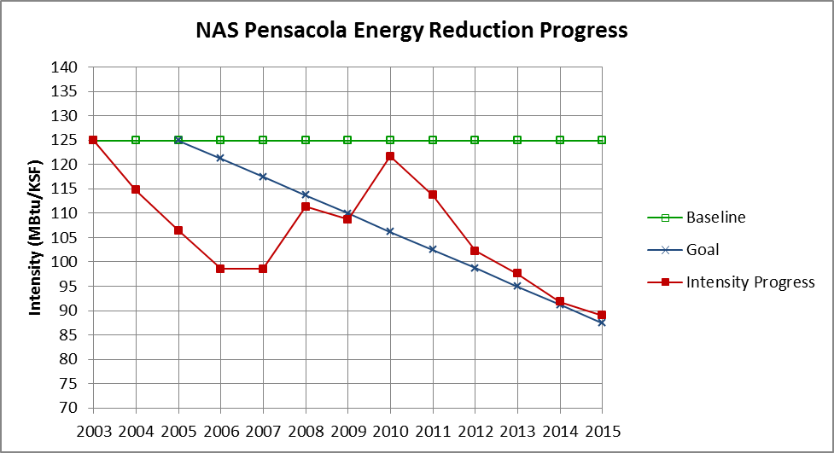
Energy Goal
Energy Intensity
  2003 Baseline 124.93 MBTU/KSF
  FY15 Goal: 87.45 MBTU/KSF
  FY15 Actual (Q2): 89.02 MBTU/KSF
  Comments/Notes: Energy consumption is decreasing but remains short of goal; additional projects and awareness campaigns planned as laid out in CO’s Energy Vision
Water Intensity
  2007 Baseline: 89.06 KGAL/KSF
  FY15 Goal: 74.81 KGAL/KSF
  FY15 Actual (Q2): 68.61 KGAL/KSF
  Comments/Notes: The CNIC baseline intensity includes housing as reported prior to 2009 and is actually 79.15 KGAL/KSF
Notes:
Inform performance progress from energy intensity reduction based on DUERS data (MBTU/KSF) reported to NFESC.

Slide 20
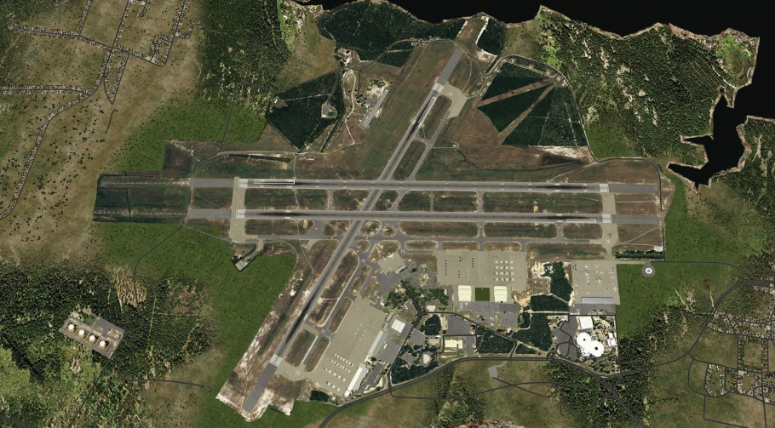
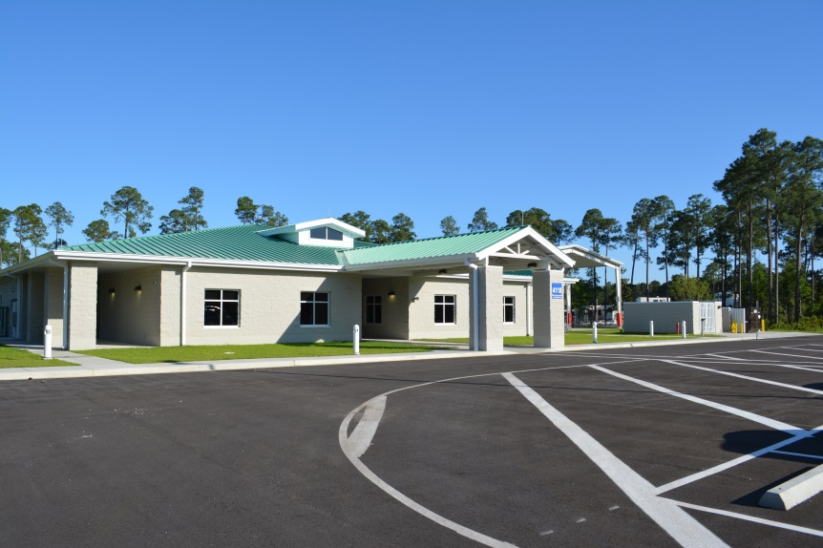
Significant Construction Projects
Repair Building 603 NETPDC/DISA - $38M
Repair Forrest Sherman Field - $37M
Financed Energy Project (43 bldgs) - $31M
Repair Corry Barracks 3709/3710 - $10.4M
Repair Corry Barracks 3701 - $7.1M
B600 NGIS Renovations - $7.3M
B781-O Relocate NOSC - $5.8M
B3251 NGIS Repair HVAC - $4.7M
Repair Bulk Fuel Farm Tanks - $3.6M
Replace NNAM Fire Alarm System - $2.2M
Repair B625C NLSO - $1.5M

Slide 21
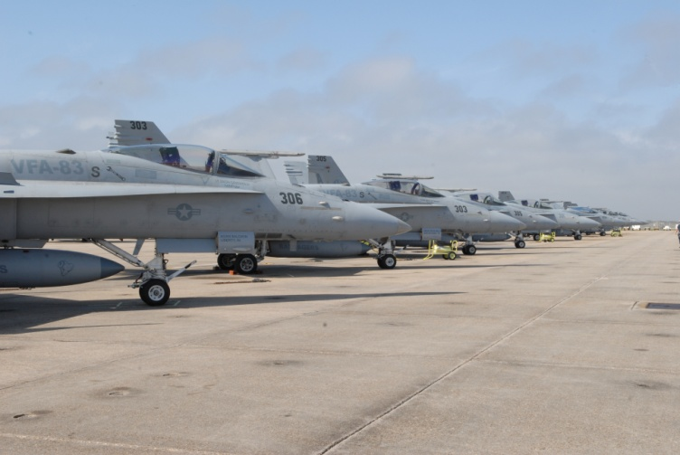
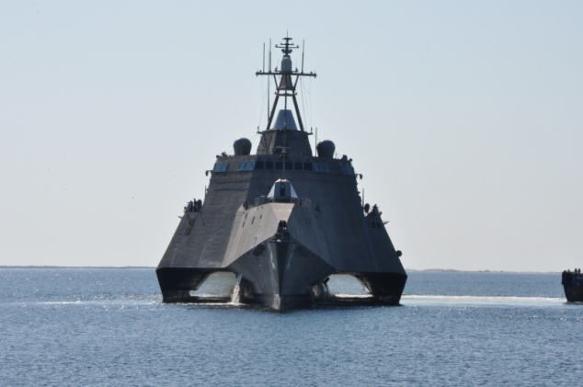
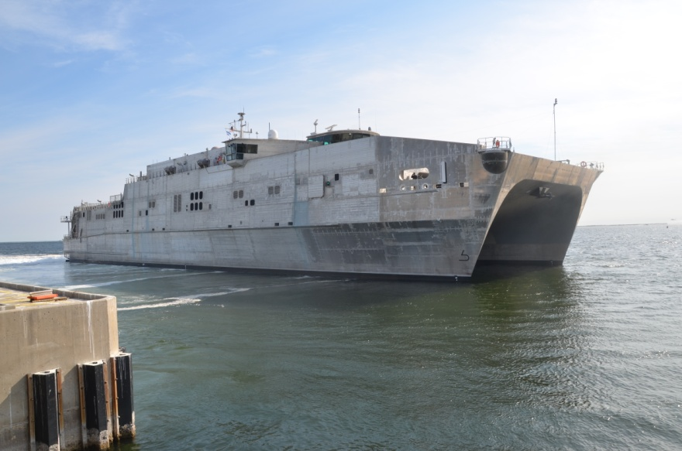
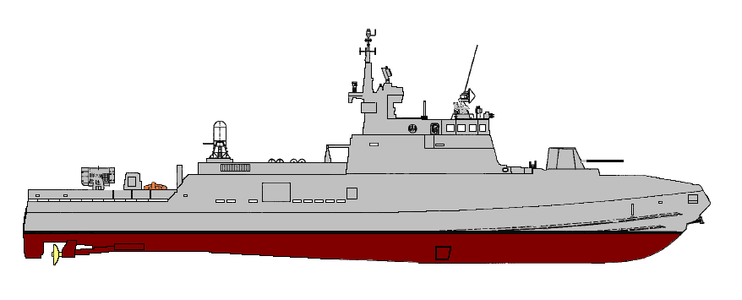
Recent & Future Operations
62.6 Meters
2013 - Egyptian Fast Missile Craft

Slide 22
Naval Air Station Pensacola
Questions?

Slide 23
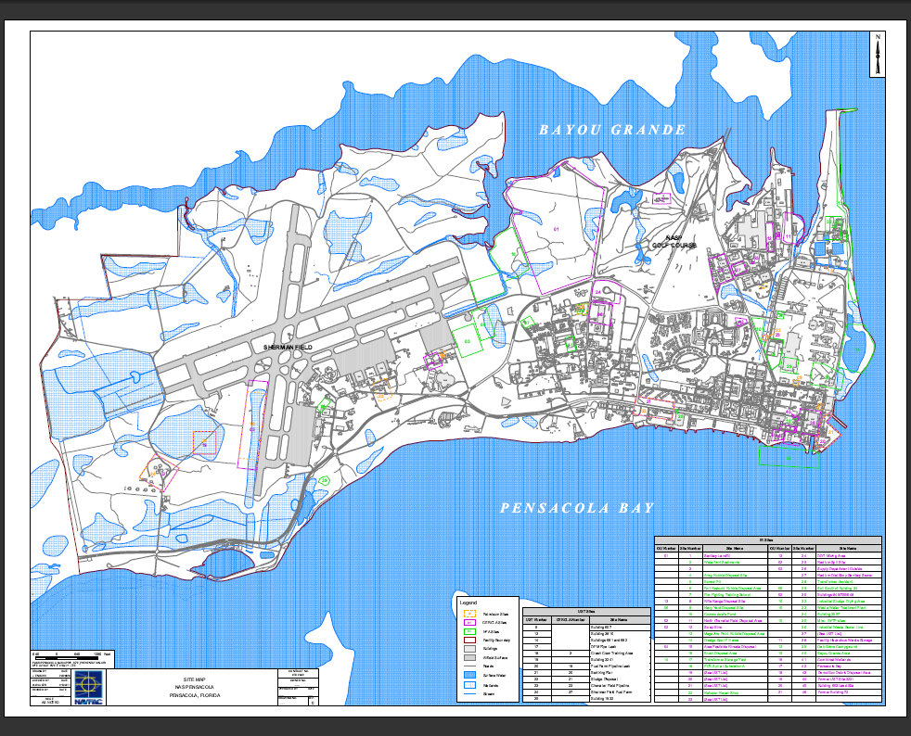
Environmentally Sensitive Areas
Installation Restoration (IR):
Total NASP IR sites is 46.
30 of the 46 IR sites have been closed.
12 of the remaining 16 IR sites have Records of Decisions (ROD’s) with Land Use Controls and long-term groundwater monitoring.
4 of the remaining 16 IR sites do not have ROD’s and are in the Remedial Investigation/Feasibility Study (RI/FS) or draft ROD phase.
Land Use Controls (LUCs):
LUCs have been implemented at eleven IR sites, which restrict land use due to contamination. See NASP IR site map for locations of IR sites with LUCs.
LUCs include groundwater extraction restrictions of surficial zone aquifer within 300’ of site boundaries.
    No intrusive activities such as soil excavations, and prohibition of residential or child care use at these sites without approval of FDEP, EPA & NASP IR manager.
IR Site Map
Notes:
Insert map or describe any environmentally sensitive areas of the installation.
Answer the following questions in bullet format:
What land is restricted in its use due to environmental factors?
What historical or cultural resources do you have? Any impacts?
What restoration sites do you have? How many have been closed? What follow on actions are required?

Slide 24
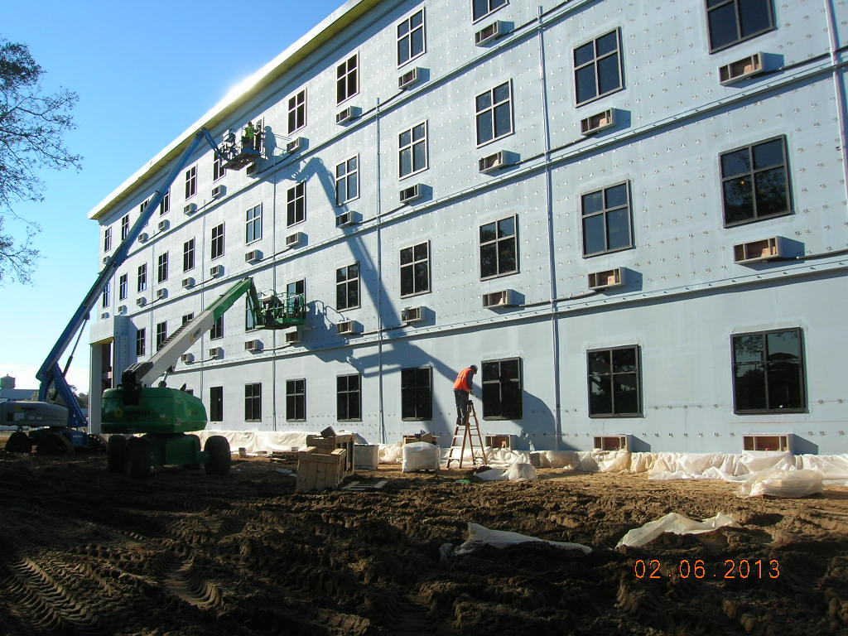
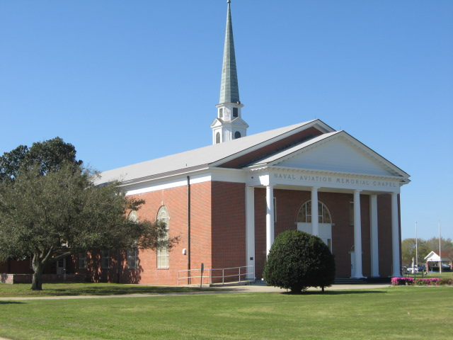
Significant Construction Projects
P724 Corry “A” School BEQ - $20M
Advanced Metering Infrastructure - $7M ARRA
Museum Chiller and Air Handling Unit
Replacement - $7M Utilities Energy Savings Contract
Satellite Pharmacy - $1.2M BUMED
Replace Boilers at Various Bldgs at NAS Pensacola- $1.6M
Automate Water Treatment Plant Pumps,
  Corry Station - $785K
Replace HVAC System, B3781 - $1.2M
Repair Forrest Sherman Field, Phase 1 - $2.1M
Repairs to B1982 Chapel - $2.9M
Repairs to BEQs 3702/3705 Corry - $9.4M
P796 ARRA Replace Street and Parking Lot
  Lights with LED - $1.9M
Energy Modernization at Buildings 3465, 3221, 3460
  and 3828 - $2.8M

