Slide 1
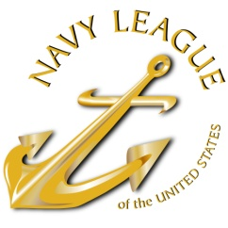
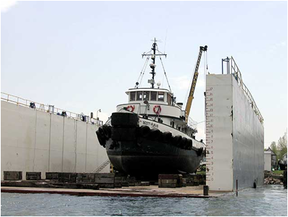
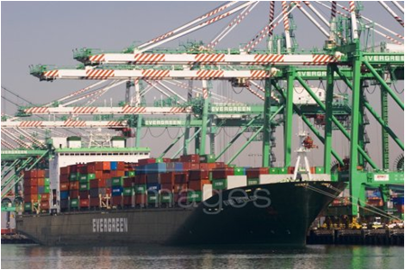

Navy League of the United States
A Critical Economic & National Security Asset:
U.S.–Flag Merchant Marine
For (Congressman/woman), (State/District), (Month) (Date), 2017
Notes:
(Note: Add the appropriate Congressperson’s name in place of “Congressman X” for each specific MOC Visit.)
Thank you for meeting with us today. The last time we visited, we discussed (topic of last meeting)
My primary focus today is to:
Provide a brief review of the Navy League and briefly highlight key local council initiatives.
Share with you of the critical challenges faced by the U.S.-Flag Merchant Marine.

Slide 2
AGENDA
About the Navy League
Introduce the Marine Transportation System
Outline U.S. Merchant Marine Programs
Maritime Security Program
Jones Act
Cargo Preference Laws
Title XI Shipbuilding Program
National Security Multi-Mission Vessel
Legislative Priorities
Conclusion
Notes:
Leading up to World War I and then again in the years preceding World War II, the United States found itself unable to respond to the economic and military needs of our nation, and therefore built a legal framework to support a privately owned U.S.-flag merchant marine.
Thus, the U.S.-flag merchant marine is intended to provide national security, firstly by supporting U.S. commerce, and secondly by providing sealift capacity for use in wars or emergencies as a bulwark against foreign control of U.S. commerce and to be available to serve U.S. national security interests.
From National Security Directive 28 in 1989: Sealift is essential both to executing this country’s forward defense strategy and to maintaining a wartime economy. The United States’ national sealift objective is to ensure that sufficient military and civil maritime resources will be available to meet defense deployment, and essential economic requirements in support of our national security strategy.

Slide 3
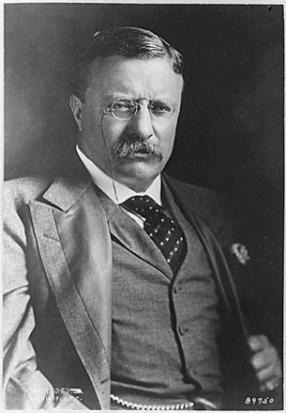
Navy League of the United States
Founded in 1902 with the support of President Teddy Roosevelt
Promotes the need for strong sea services
Civilian organization
  230 Local Councils
  42,000 members worldwide
Our Goal: to educate the public and elected officials on the importance of a strong maritime component for our National Security
Supports and advocates for members of the Navy, Marine Corps, Coast Guard, and U.S. Flag Merchant Marine
Notes:
Please tailor the discussion to your local council:
__#__ NL members-strong; more than __ in the state of -----.
Civilian Volunteers come from a variety of backgrounds, but all believe in strong sea services.
Key Activities: Junior Navy and Marine Corps ROTC, Adopt-a-Ship, public education on sea services, ship commissionings, Naval Sea Cadets Corps

Slide 4
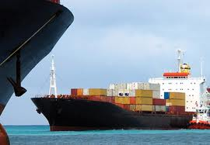

The U.S. Marine Transportation System ( MTS)
The U.S. Marine Transportation System (MTS) consists of waterways, ports and their intermodal connections.
As a world trade leader, the United States requires a technologically advanced, secure, efficient and environmentally sound Marine Transportation System.
Notes:
http://www.navigationdatacenter.us/factcard/factcard15.pdf
http://www.cmts.gov/Background/Index.aspx
http://www.cmts.gov/downloads/CMTS_Executive_Summary_Performance_Measures_Report_FINAL_2015-07-06_PDF.pdf
MTS keeps our economy secure. Every day we use our seaports and waterways to move trillions of dollars worth of export, import, and domestic cargo.
MTS allows vessels and vehicles that are crucial to the U.S. economy to make safe and secure transit.
The MTS consists of waterways, ports, and intermodal landside connections that allow the various modes of transportation to move people and goods to, from, and on the water and includes the following: ( http://www.cmts.gov/downloads/CMTS_MTS_Fact_Sheet_9.15.14_FINAL.pdf )
12,380 Miles of Coastline
Great Lakes and St. Lawrence Seaway
25,320 miles of navigable waterways (2011)
8,214 U.S. Waterway Facilities (2013)
236 locks at 192 locations
48,600 Federal Aid to Navigation
Numerous recreational marinas
Over 174,000 miles of rail connecting all 48 contiguous States, as well as Canada and Mexico
Over 45,000 miles of interstate highway, supported by over 115,000 miles of other roadways
Over 1,400 designated intermodal connections
Over 36 million TEUs (twenty-foot equivalent units) and 1.4 billion short tons of foreign trade were handled in 2012 on U.S. Ports and Waterways, with a value of nearly $1.8 trillion dollars

Slide 5
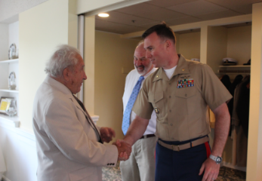
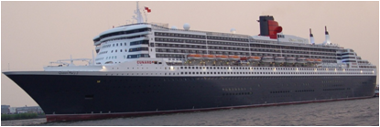
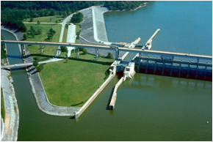
The U.S. Marine Transportation System
The U.S. Maritime Transportation System (MTS):
  sustains approximately 13.3 million jobs.
  contributes more than $649 Billion per year to the U.S. GDP.
  employs over 66,000 water transportation workers and 36,000 mariners providing more than $4B in wages.
  supports deployment of 95% of military equipment/supplies.
International Trade:
  accounts for 30% of U.S. economy
  over 99% of overseas cargo tonnage moves by sea.
Notes:
http://www.marad.dot.gov/wp-content/uploads/pdf/2013-ANNUAL-REPORT-Final.pdf
http://trade.gov/mas/ian/build/groups/public/@tg_ian/documents/webcontent/tg_ian_002065.pdf
http://www.rita.dot.gov/bts/sites/rita.dot.gov.bts/files/FF%26F_complete.pdf
Important Facts
Almost 36 million loaded Twenty Foot Equivalent Containers arrived/departed U.S. ports in 2014 per Core of Engineers 2014 Transportation Facts & Figures
MTS activities contribute over $212 billion in annual port sector federal/state/local taxes (2011)
International trade now accounts for fully 30 percent of the U.S. GDP (2013)
99% of the tonnage of overseas trade (65% by value) enters or leaves the U.S. by ship (2014) (doesn’t include Canada or Mexico)
95% figure is quoted from various USTRANSCOM studies (includes unit equipment, ordnance, supplies and fuel)
The United States continues to depend primarily on oceanborne shipments for its international trade. As the world's largest trading nation (2nd largest for merchandise) the United States exports and imports about one-twelfth of global merchandise trade in value annually. (2014 UNCTAD figures.) The largest part of this merchandise trade - over 1.4 billion short tons of cargo (73.5% of 2012 total—including Canada and Mexico) was moved by water. Another billion tons of cargo is carried in domestic waterborne movements.

Slide 6
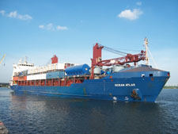
The U.S. Marine Transportation System
Freight flowing through MTS is expected to double between 2017-2040.
MTS port improvements to support new Panama Canal & larger sized ships will be critical to our nation’s prosperity and security.
Aging Inland Waterways Requires Maintenance & Refurbishment
As citizens, we need to raise awareness in our communities about this concern and ensure the Harbor Maintenance Trust Funds are used to keep the MTS functioning optimally.
We must invest in both modernization & maintenance of waterside infrastructure—ports and
Inland waterways!
Notes:
https://www.transportation.gov/sites/dot.gov/files/docs/DRAFT_NFSP_for_Public_Comment_508_10%2015%2015%20v1.pdf
According to Draft National Strategic Freight Plan (10/15/15), container traffic at ports more than doubles by 2040, and inland waterways traffic will increase about one third, creating greater congestion on overburdened systems—we need a truly seamless, integrated, multimodal transportation system with an expanded America’s Marine Highway system to meet our needs.
Costs attributable to delays in the nation’s inland waterways system were $33 billion in 2010, and it is expected to increase to nearly $49 billion by 2020. (source: 2012 report by the American Society of Civil Engineers).
A Vessel Calls Snapshot, 2011 report, released updated in November 2013 by MARAD, shows that not only are more ships calling at U.S. ports, the ships are continuing the get bigger. In 2011, 7,836 oceangoing vessels made 68,036 calls at U.S. ports. Vessel calls were up 7.9% from five years earlier, and up 13.6% from 2010. Of the 2011 vessel calls, 35% were tankers; 32.5% were containerships; 16.1% were dry bulk vessels; 9.1% were roll-on/roll-off (Ro-Ro) vessels; and 5.9% were general cargo ships.
As larger and larger ships call our ports, especially after the new Panama Canal lock open, our ports, terminals and intermodal connectors, rail and road, are being stretched to their limits causing delivery delays, congestion, and major loss of productivity. Without improvements, our ability to rapidly deploy major combat formations through our Strategic Ports will be seriously hampered.
Our ports and waterways are critical national security assets. Port should get a fair share of the DOT Transportation Investment Generating Economic Recovery (TIGER) grants for port related infrastructure. Of the $500M of the FY2015 TIGER Grants, ports only received $44.3M or 9%, several percent lower than 13%+ average over the last five years. (AAPA)
While the FY17 budget does provide considerable new resources to improve the intermodal freight transportation system under the “Fixing America’s Surface Transportation (FAST)” Act, the budget would significantly cut funding for maintenance and modernization of federal navigation channels, the critical waterside infrastructure that connect our ports and nation to the world marketplace which is desperately needed to ensure America’s international competitiveness and to allow the nation’s ports to accommodate increasingly large, sea-going vessels.
When Congress passed the overwhelmingly-supported and bipartisan Water Resources and Reform Development Act (WRRDA) in 2014, it established annual incremental increases for Harbor Maintenance Tax funded work. That would lead to full use of revenues in fiscal 2025. Not only does the President’s proposed fiscal 2017 budget fail to hit the 71% HMT target, it also fails to continue funding the HMT donor equity provisions that Congress initiated last year. The $951 million requested by the President for maintaining America’s deep-draft harbors is 22 percent less than the $1.24 billion appropriated by Congress for fiscal 2016.
Specifically, the budget:
proposes $4.620 billion for the U.S. Army Corps of Engineers’ Civil Works program, a 29.8% cut from the $5.989 billion FY’16 appropriation for the program;
proposes $1.090 billion for the Construction account, a 41.5% reduction from FY16’s $1.862 billion;
proposes $2.705 billion for the Operations and Maintenance (O&M) account, $5 million less than the Administration requested last year for the account, but a $432 million cut (13.8%) from what Congress appropriated for the current fiscal year;
requests $85 million for General Investigations, but provides no funds for Preliminary Engineering and Design (PED) for the Navigation Ecosystem Sustainability Program (NESP), authorized in WRDA 2007;
suggests a $1.289 billion inland waterways user fee. Similar proposals in the past have been soundly rejected by Congress;
requests $986 million be appropriated from the Harbor Maintenance Trust Fund (HMTF), down from $1.24 billion in FY 2016 and $1.34 billion that should be the FY2017 target.
(data from: http://waterwayscouncil.org/)

Slide 7
U.S. Merchant Marine Programs
The United States has five pillars to support our maritime requirements:
Maritime Security Program—underfunded!
Jones Act—under attack!
Cargo Preference Laws—under attack!
Title XI Shipbuilding Program—terminated!
National Security Multi-Mission Vessel—unfunded!
Notes:
Unfortunately these programs are under attack and underfunded by Washington. These laws exist for a reason---during every major conflict or disaster, the need for a varied and broad-based U.S. Merchant Marine fleet has been realized.
The impact will discussed in the following slides.

Slide 8
Maritime Security Program---UNDERFUNDED
The MSP guarantees that the Department of Defense (DOD) will have needed sealift capacity using commercial vessels manned by U.S.-trained citizen merchant mariners.
DOD reports that MSP is the most economical solution to provide sealift resources in time of National Emergency.
Sixty U.S.-flag vessels under contract.
$300 million currently authorized for 60 vessels; operated by 13 companies.
FY17 Appropriation of $300 million ($5M/Ship) needs to be sustained in FY18 and thereafter!
FY18 Budget Request of $210M Must be Increased to $300M!
Notes:
DOD estimates current sealift requirements would cost $10 billion in capital costs and $1 billion in annual operations costs to replace the resources available from MSP for $300 million per year.
MSP must be funded annually by Congress even though it is authorized through 2025.
The 60 vessel Maritime Security Program (MSP) provides the foundation to support the U.S. commercial fleet operating in international trade and an economically viable U.S.-flag Merchant Marine for national defense and economic security. Sustaining the MSP fleet component of the Voluntary Intermodal Sealift Agreement (VISA) for future surge and sustainment operations requires full long-term funding for program stability, including continued exemption from sequestration, even during continuing resolutions. Additionally, to compensate for further reductions in military and other preference cargoes and to ensure continued economic viability, the amount of payment should cover the almost full extra cost of U.S. flag operation, ( est. $5-7M/ship/year). At least $5M/year/ship ($300M total) is needed now to keep these ships under U.S.-flag since ship operators cannot sustain losses indefinitely.
The FY 2016 Omnibus clearly articulated Congress’s commitment to this program. They raised funding to $210M in FY2016, with the plan to escalate to $300M for FY2017-FY2020. The $300M provided in the FY17 Consolidated Appropriation Act fulfills that commitment but FY18 PresBud Submit regresses back to FY17 Continuing Resolution level of $210M. We need to get $300M appropriated in FY18 and thereafter, otherwise large numbers of these ships will reflag because they can’t afford to operate at a loss.
In November, 2015, Rear Admiral Thomas Shannon, Commander, Military Sealift Command, stated that “without a strong U.S.-flagged merchant marine, we cannot answer the call and carry our nation to war.” He went on to express strong support for the MSP as a key component necessary to help maintain our U.S.-flag merchant marine, stating that “the Maritime Security Program is a bargain.”

Slide 9
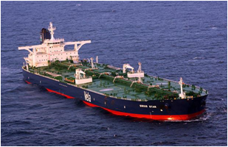
The Jones Act
The Jones Act mandates that cargo moving between U.S. ports must be carried on vessels that are U.S.- flagged & built, and crewed & owned by U.S. Citizens.
Jones Act:
  generates approximately $100 billion in total annual economic output and $11 billion in U.S. taxes.
  supports approximately 500,000 American jobs and $28 billion in wages.
  provides more than half of U.S.-flag and 100% of U.S. built oceangoing commercial cargo vessels.
Notes:
Vessels in domestic waterborne trade (includes tugs and barges on the inland waterways and oceangoing vessels on coastwise and non-contiguous domestic trades) are required to be owned by U.S. citizens, built in the United States and crewed by U.S. mariners. The Jones Act keeps American shipping companies, shipyards, mariners, and thousands of people working. Since it provides for the majority of ocean going ships under the U.S.-flag (91 of 169 as of 2FEB16), any weakening of the Jones Act would dramatically weaken national and economic security.
The U.S. Navy and the Navy League both understand that maintaining longstanding U.S. maritime law boosts our economy and helps protect our homeland.
Enacted in 1920, the Jones Act has been broadly supported by every Congress and administration since its passage and is considered a key element in the nation’s defense capabilities.
The arguments in support of the Jones Act are compelling ones: jobs, safety, environmental protection, efficiency, and national security, all provided at no expense to the U.S. taxpayer and without a dime of subsidy from the federal government.
There are currently 50 other countries that have similar cabotage legislation in place.
Jones Act jobs include workers engaged in the construction of vessels for the domestic trades in United States shipyards, U.S.-flag vessel operations, and related service and supply industries.
As of 2FEB16, 91 of the 169 (54%) oceangoing vessels over 1000 Gross Registered Tons under U.S.-flag are Jones Act ships. All of these ships are U.S. built while none of the U.S.-flag ships in foreign trade are U.S. built.
More than 27,000 Jones Act barges move about 800 million tons of raw materials and finished products each year. America’s domestic tug and barge industry provides direct employment for more than 30,000 mariners working on tugs.
The size and scope of the domestic maritime industry is staggering, yet often overlooked, American maritime:
Moves almost 1 billion-plus tons of cargo annually, with a market value of $400 billion;
Transports more than 100 million passengers annually ride ferries and excursion boats;
74,000 jobs on vessels and at shipyards;
Sustains nearly 500,000 jobs in total;
Produces nearly $100 billion in annual economic output;
$29 billion in annual wages spent in virtually every community in the United States;
$11 billion in taxes per annum; and
$46 billion added to the value of U.S. economic output each year.
http://www.americanmaritimepartnership.com/economy-security/jones-act/

Slide 10
The Jones Act—UNDER ATTACK!
Many have recently called for the Jones Act to be repealed, blaming it for higher fuel prices and other unrelated issues.
Legislative attacks, both national and state, and proposed international trade agreements (WTO and EU) could negatively impact the Jones Act.
The Commandant of the Coast Guard testified before Congress that the Jones Act is critical to homeland security.
Stop this attack on the domestic U.S.-flagged Merchant Marine: It provides the majority of our active oceangoing cargo ships for national security
Notes:
Today, the Jones Act is held responsible daily for increasing gasoline prices, and excessively high prices for good in Puerto Rico and Hawaii, despite clear evidence to the contrary.
At every opportunity Senator McCain introduces legislation or amendments to either rescind or modify the Jones Act. In January 2016, he submitted an amendment to Energy & Water bill to block the American-built requirement in the Jones Act. Outcry has been swift and vocal. We see a version of this amendment offered annually, so we must be vigilant in opposing it.
State legislators from Alaska, Hawaii, Puerto Rico, and Guam continue to meet as a group to pressure Washington into repealing the Jones Act provisions. Advocacy groups such as the Heritage Foundation, the Capitol Research Center, and the Institute for Liberty continue to call for the repeal of the Jones Act, calling it unwarranted interference in the free market.
All these parties attacking the Jones Act refuse to acknowledge how critical these ships and crews are for economic security and national defense. The Jones Act provides more than half of the oceangoing ships under U.S. flag and their trained crews critical for operating our reserve sealift fleets. The critics never provide an alternative to meeting these critical needs.
World Trade Organization “plurilateral” service trade talks among the U.S. and 21 other countries and European Union talks are something that should be continually monitored as the EU isn’t likely to give up on their calls to repeal the Jones Act. The Trans Pacific Partnership (TPP – a trade agreement currently being negotiated with 11 countries along the Pacific Rim) should also be monitored for any signs of anti-Jones Act action. The U.S. has never agreed to include maritime services in trade negotiation and it needs to keep it that way.

Slide 11
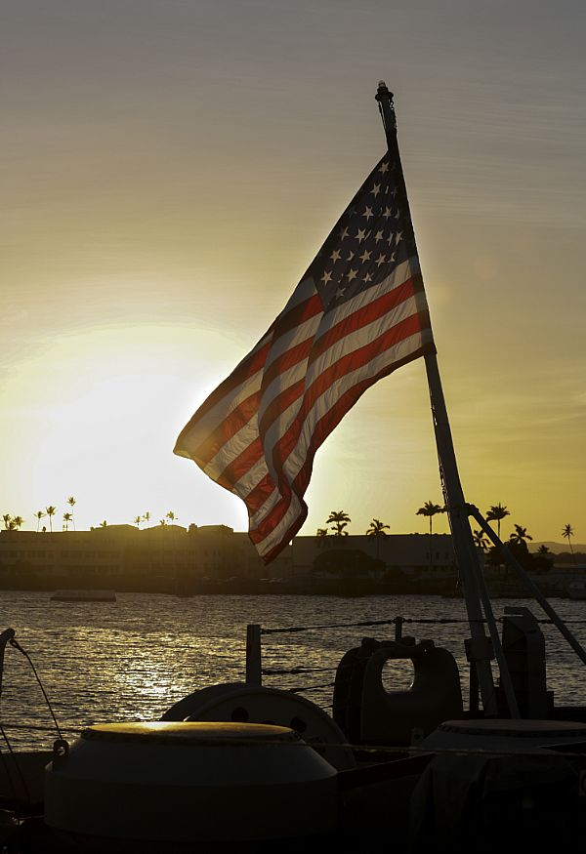
Cargo Preference Laws
To ensure sealift capacity and guarantee a skilled cadre of U.S. seafarers operating ships in foreign trade, Congress enacted laws to require certain percentages of government to be carried on U.S.-flagged, owned, and crewed vessels.
Cargo preference covers government
impelled cargo movement on international
waters; composed of Agricultural, Civilian
Agencies, and Military Cargoes.
Cargo preference is commonplace among
the world’s seafaring nations.
Notes:
We rely on the availability of U.S. Merchant Marine vessels, infrastructure and manpower to ensure the safe delivery of military equipment and supplies to our soldiers; the same capabilities replicated by the Department of Defense would cost billions more. Once the U.S. flag Merchant Marine capability is diminished due to the impacts of this program cancellation, as would be the case if MSP were underfunded or the Jones Act was rescinded, the United States could be forced to depend on politically unreliable foreign ships and crews to deliver important military and relief cargoes during times of war and national emergency. All three of these programs must be enforced and robustly funded (in case of MSP) if we are to have an active merchant marine to sustain combat operations in time of war and to provide the manpower needed to operate the government owned ships maintained by Navy and MARAD in reduced operating status (ROS) in peacetime.
Impelled cargo – ocean-borne cargo that is moving either as a direct result of federal government involvement, or indirectly through financial sponsorship of a federal program, or in connection with a guarantee provided by the federal government.
Percentage requirements for use of American Bottoms is 50% Agricultural, 50% Civilian Agencies, 100% of Export-Import Bank, and 100% Military Cargos.
Details of threats to cargo preference are in Slide 12.
U.S. Cargo Preference Laws provide the most cost-effective sealift capability available to the U.S. Government.
U.S. Cargo Preference Laws ensure that the vessels and attendant intermodal systems, trained crews, and vessel service industries continue to prosper.
U.S. Cargo Preference Laws also ensure that the oceans are not dominated solely by foreign interests and enhance the U.S. balance of payment position.

Slide 12
Cargo Preference Laws—UNDER ATTACK!
Government-impelled cargoes have declined 35% since 2014:
  Reduced military operations in Iraq & Afghanistan
  Legislation reduced cargo preference requirements for food aid (75% to 50%)
  U.S. sourced Food Aid via U.S.-flag ships reduced by 25%, the FY2018 budget request terminates Food for Peace Program!
  Export-Import Bank authority is capped, limiting jobs for American mariners.
  Existing preference regulations are unenforced
  The number of U.S. vessels in international trade has declined by almost 25%: from 106 to 81, over the last four years (60 supported by MSP!). Must Restore Food for Peace or Lose More!
Notes:
While the domestic component (Jones Act) of the U.S. flag fleet is stabilizing because of recent recapitalization of ships in the Hawaii and Puerto Rican trades and the new tankers being added to transport shale oil, the number of non-Jones Act U.S. vessels in international trade have significantly declined by more than 25 percent, from 106 to 81, over the last four years. This is primarily the result of a 35% decline in government impelled cargoes since 2014 due to:
(1) reduced military operations in Iraq and Afghanistan,
(2) legislation that reduced cargo preference requirements for food aid from 75% to 50%, and
(3) inability to enforce cargo preference regulations.
Additionally, the deactivation of Maritime Prepositioning Squadron One and the reduction of Army prepositioning ships reduced the number of seagoing billets. These losses of “blue water” U.S.-flagged vessels since January 2010 have resulted in a loss of over 2,800 mariner jobs. MARAD assesses we are at the point, below 90 ships in international trade, where our ability to crew all U.S.-flagged commercial and government reserve sealift vessels for a sustained period of more than six to eight months is no longer certain.
FY2017 request attempted to reduce the program significantly. FY2017 Consolidated Appropriation Act increased food aid funding overall by $200M, helping to stem the further decline of U.S.-flag shipping in international trade, assuming the Ex-Im Bank regains its ability to authorize guarantees over $10M/project until a third commissioner is confirmed by the Senate. However, the 2018 PresBud Submit terminated the PL480 Title II – Food for Peace Program, potentially eliminating most agricultural preference cargoes—resulting in loss of many of the vessels in foreign trade outside of the Maritime Security Program
Congress mandated MARAD issue regulations to enforce other agencies to comply with Cargo Preference Laws—but they have been tied up for years in OMB because those agencies don’t want to spend the extra funds necessary to obey the law!
81 ship number is from 1 May 2017MARAD U.S.-Flag Vessel Inventory of Oceangoing Vessels

Slide 13
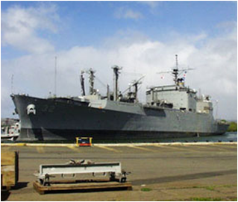
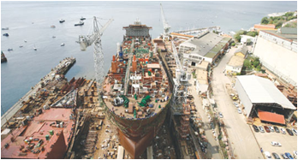
Title XI Federal Ship Financing Program
Title XI promotes U.S. shipyard growth and modernization through long term debt repayment guarantees.
Encourages U.S. ship owners to obtain new vessels from U.S. shipyards cost effectively and shipbuilders to modernize.
Notes:
The Federal Ship Financing Program (commonly referred to as “Title XI”) promotes U.S. Merchant Marine fleet and U.S. shipyard growth and modernization. Through long term debt repayment guarantees, the Program encourages U.S. ship owners to obtain new vessels from U. S. shipyards cost effectively. It also assists U.S. shipyards with modernizing their facilities for building and repairing vessels. The repayment term allowed under the program generally is much longer and the interest rates are lower than those available from the commercial lending market because the obligations guaranteed by the U.S. Government. Many other countries have similar financial programs that support their domestic shipbuilding industry.
Title XI enables shipping companies and shipyards to make plans, but these companies need assurance that the program will be available to facilitate investment in vessels to be built or rebuilt in U.S. shipyards.

Slide 14
Title XI Federal Ship Financing Program—TERMINATED!
Provides a strong return for the government, as each appropriated Title XI dollar can leverage up to $12 of private investment.
Helps retain jobs for thousands of shipyard welders, electricians, and fitters necessary to maintain a healthy Naval shipbuilding industrial base.
Several Title XI applications need funding.
Requires annual appropriations $25-35M/year to be effective—but budget requests termination!
Must Restore and Properly Fund Title XI!
Notes:
The availability of a modern, well-funded Title XI program will facilitate the needed replacement of the domestic cargo fleet, ensuring the continued availability of vessels and seagoing personnel to meet the economic and military security requirements of our nation.
The Navy supports the Jones Act and Title XI programs because they help maintain the commercial shipbuilding industrial base needed to build Navy auxiliaries and support ships at a reasonable cost.
The Administration has not requested any funding for Title XI since 2002. Occasionally, Congress provides plus-ups, such as $35M in FY14 and $5M in FY16, but we really need about $25-35M/year (2-4 ocean going ships) for this program to accomplish the objective of maintaining a strong shipbuilding industrial base for large oceangoing ships—needed for domestic commerce and Naval auxiliaries and sealift.
Although there have been problems with how the program was administered a decade or two ago, recent loan guarantees awarded with the Congressional funds provided, have performed well. While Congress didn’t add any additional funds in FY17, it did provide $3M to continue administer the current portfolio.

Slide 15
National Security Multi-Mission Vessel (NSMV)
Six State Maritime Academy Training Vessels reaching end of service-life
  TS EMPIRE STATE (NY Maritime College) is 55 years old; 8 years beyond service life and currently can operate through 2019.
MARAD initiated design of multi-mission vessels in FY15:
  Serve as replacement training vessels for 6 state maritime academies.
  Capable of providing humanitarian assistance and disaster relief.
  FY18 PresBud provides NO funding for NSMV!
MARAD Needs $36M now to start detailed design/fund long lead material to ensure first in class delivers before 2020!
Notes:
MARAD maintains a fleet of U.S. Government owned vessels operated by the SMAs. These vessels are used to train merchant marine officer candidates as part of MARAD’s mission to foster a strong U.S.-flag merchant marine.
Each SMA training program meets internationally agreed upon standards followed by the USCG, including sea service time, training, and competency requirements. The MARAD-owned training ships play a central, critical role in these programs.
The current fleet of vessels have also supported other U.S. Government agencies in humanitarian assistance and disaster relief (HA/DR) roles. The design of the NSMMV incorporates specific HA/DR features including: Potential for RoRo space with Side Ramp, Capability to install Cargo Crane, Container and Cargo Stowage on Main Deck, Capability for Modules on Main Deck, Helicopter Landing Capability, Command & Communications Suite, Enhanced Medical & Treatment Spaces, and Berthing spaces available for use by HA/DR personnel.
The current fleet of vessels range in age, mission capability and material condition. The training ship fleet is aging. For example, the TS EMPIRE STATE, on loan from MARAD and operated by the State University of New York (SUNY) Maritime College, is the oldest training ship in the fleet. This training ship is 55 years old, operating seven years beyond its original designed service life extension. Currently, this training ship has a USCG Certificate of Inspection to be sailed as a public nautical school ship, and is in full Class with the American Bureau of Shipping (ABS) through 2019.
If the TS EMPIRE STATE is taken out of service without having an alternative solution, the overall SMA mariner training program is expected to lose 36 percent of the existing training ship capacity. This will be a major setback to meet the rising national demand for mariners.
Each of the SMAs operates their respective training ship as part of a USCG-approved training program. They graduate credentialed merchant mariners who undergo a rigorous four-year maritime education and training program. A necessary prerequisite to earning the credential is a minimum of 360 days of experiential learning on board a ship.
Broadly speaking, the SMA training ships are used to achieve two objectives: 1) to allow merchant marine officer candidates to acquire sea service time and 2) to provide students with a modern, realistic and effective real world learning environment. Shipboard operational training is further reinforced during the normal academic year by using the ship as a floating laboratory while the ship is not on an annual training cruise.
FY17 Omnibus Appropriation Act provided $6M for continued design of the NSMV. However, the preliminary design is essentially complete with funds provided by the Navy in FY2015 and $5M provided by Congress for that purpose in FY16. The NSMMV needs to be put under contract in FY18 to ensure timely replacement of the TS Empire State. About $36M is needed in FY18 (as authorized in Senate’s MARAD Authorization Bill) to get the program underway; remaining funding of $250-300M can be appropriated in FY19/20.
(Bullets/Notes primarily taken from MARAD FY17 Budget Estimates)

Slide 16
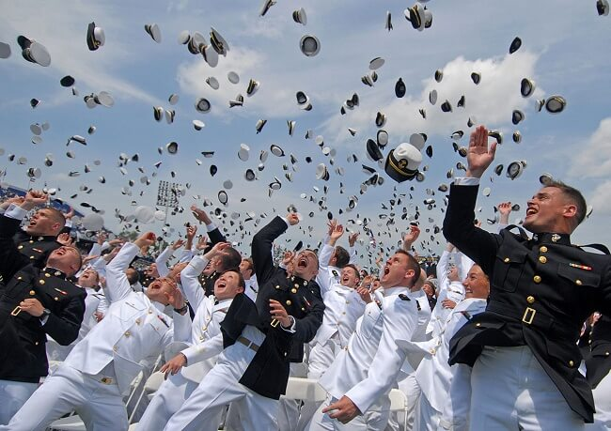
FY2018 Priorities
Continue to fund the Maritime Security Program at the $300M level authorized by Congress to ensure its viability.
Protect the Jones Act from Legislative Changes.
Fund maritime academy training & ops., including $36M for National Security Multi-Mission Vessel design & Long Lead items.
Ensure the Administration enforces Cargo Preference Laws via strong rulemaking; and reject the major funding cuts for Food Aid Cargos.
Provide funding for the Title XI Ship Financing Program of at least $25-35M/year.
Support the Department of Transportation’s
Marine Highway initiatives that would transport
more freight cargo in national waterways and
exempts waterborne cargo, shipped between U.S.
ports from the Harbor Maintenance Tax.
Notes:
These are the needs that our Navy League advocates for the U.S.-flag Merchant Marine.
The last bullet is the only one on this slide that would help grow, vice maintain, the U.S.-flag merchant marine by encouraging new domestic coastwise services to carry some of the forecasted exponential growth in domestic freight—specifically moving domestic containers and trainers off the concrete highways (I-95, I-10, I-5) onto the Marine Highways. This would be accomplished via containerships, container/Roll-On Roll-Off (Ro-Ro) ships, or trailer ships built in U.S. shipyards. The latter two classes would be ideal for military sealift and could be a potential means of recapitalizing the aging Ready Reserve Force (RRF) of 35 Ro-Ro’s that reach the end of their service life in the next decade. The Navy developed a business case analysis that indicates that this might be a significantly more cost effective means of recapitalizing the RRF compared to replacing with new construction ships built for lay-up.
The Princeton Review ranked the State University of New York Maritime College among the top 10 schools in the nation for career placement after graduation. The college for years has had nearly 100 percent of its graduates working in careers of their choice after graduation.

Slide 17
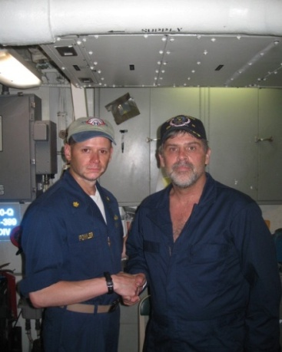
FY2018 Priorities
  Support legislation to export of a percentage of LNG and crude oil on U.S. built, U.S. Flag ships to help stem the decline of U.S. shipping in foreign trade and provide additional work for U.S. shipyards.
  Supply full funding of the WRRDA specified authorizations from the Harbor Maintenance Trust Fund to maintain America’s harbors, inland locks, dams, and waterways. Oppose Lock/Dam User Fee
Fully fund the Maritime Administration’s Ready Reserve Force of 46 vessels and maintained in high readiness status.
  The Navy League urges Congress to support these maritime programs to ensure the U.S. maritime sector
  can remain competitive in the global economy.
Notes:
The first bullet is a potential means of stemming the decline of U.S-flag ships in foreign commerce—by creating a new preference for the movement of LNG & crude oil exports on U.S. flag, U.S. built vessels. U.S. construction would have to be phased in since it would take U.S. shipyards about 6 years before delivering new LNG tankers, though there a few elderly U.S. built LNG tankers that could be reflagged in the interim. Congressman Garamendi (D-CA) has offered legislation in the past that would enact such a program.
We must ensure funds in the Harbor Maintenance Trust Fund (HMTF) are utilized for the intended purpose of dredging and maintaining coastal ports, harbors and waterways and prevent misuse of the HMTF tax revenues. The Water Resources Reform and Development Act, or WRRDA, which passed in 2014, mandated an escalated spending plan to ensure an increasing portion of the fund is used for its intended purposed. We are pleased that Congress full met the FY17 funding target even though the Administration has not in its budget request. FY18 PresBud again underfunds HMTF expenditures and wants to impose an unfair user fee to help fund Inland Waterways even though industry has had diesel fuel taxes recently raised to cover its share to fund the Inland Water Trust Fund.
Although recent Navy funding for MARAD’s Ready Reserve Force (RRF) of 46 vessels has been barely adequate, the FY17 budget/appropriation just added of $8.5M to the FY16 level to $281M for FY17 (vs. $291M in FY15). FY18 PresBud only asks for $289M, which is inadequate to maintain the readiness of a fleet that average age is more than 40 years old. USTRANSCOM and Navy have suggested that they will have to extend the service lives of these ships beyond their 50 years. USTRANSCOM/Navy need to provide Congress a RRF recapitalization plan as promised during June 2015 hearings, other than taking American tax funds to buy aged foreign hulls that provide no work for U.S. shipyards that are running out of commercial work. These aging ships make up the majority of the surge sealift capacity and unless they are properly maintained in a 5 day readiness status, the Nation’s ability to rapidly deploy its ground forces will be in serious jeopardy.

Slide 18
The Merchant Marine Fleet Needs Congress!
  The Merchant Marine fleet is facing a perfect storm of factors that are shrinking the fleet.
  Future ship and Mariner shortages will have significant impacts on our strategic sealift capability.
  “Without a healthy U.S. merchant fleet, we lack the capability to deliver our military forces to war.”
--Lt. Gen. Stephen Lyons, Deputy commander, U.S. Transportation Command
Notes:
By 2022, the United States will need “70,000 new people” for the nation’s maritime fleet.
Lt. Gen. Lyons testified before Congress in March 2016 that “there are questions, based on experiences in earlier conflicts, about the willingness of foreign owners with foreign crews to go into harm’s way to deliver necessary supplies and equipment to American forces operating in combat.” (USNI News).

Slide 19
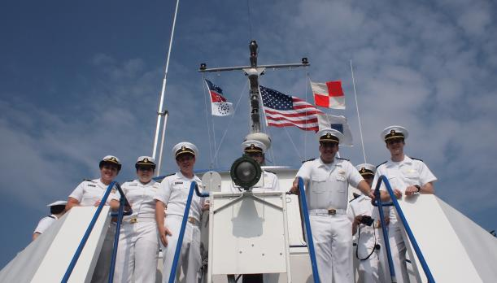
Navy League of the United States
<presenter name>
<title>
<council name>
<presenter email address>
<presenter phone number>
<council website address>
Join the Congressional Shipbuilding & Maritime Caucuses to help support the American shipbuilding and maritime communities!
Notes:
Encourage your Representative to join the Congressional Shipbuilding and Maritime Caucuses, if they haven’t already. The Navy League sponsors a quarterly breakfast series with the Shipbuilding Caucus to explore topics of interest to the shipbuilding community. It’s very bipartisan, co-chaired by Rep. Rob Wittman (R-VA) and Rep. Joe Courtney (D-CT). The Maritime Caucus is co-chaired by Rep. David Joyce (R-OH) & Cedric Richmond (D-LA).

